Slide 1
Save the children
Presented by Mr. Rodgers & Friends: john Rodgers, David Nguyen, Austin Simeone, & Hannah Kosinovsky

Slide 2
Business objectives

Slide 3
Business objectives
Our world is becoming less poor and more healthy with every year. This is encouraging news, but we must also study potential causes for and hindrances to this phenomenon.
Question: Where should the Bill & Melinda Gates Foundation (BMGF) expand?
Hypothesis: The Bill & Melinda Gates Foundation should expand to countries with low literacy rates and low female occupation rates because those two variables correspond to low survival rates.

Slide 4
Data source

Slide 5
Where the data came from
We obtained the data from the World Bank.
The data contains statistics on all the countries in the world from 1960 to 2016.
The reason we chose this data is it included education, occupation, and gender.
There are 162 indicator variables for which data was collected, but data was not available for every indicator variable.

Slide 6
Methodology

Slide 7
steps
We performed a linear regression to determine if there is a correlation between literacy rate and survival rate.
We performed a multiple regression on 4 variables: mother’s position maternity, female life expectancy, female participation, and female manager.

Slide 8
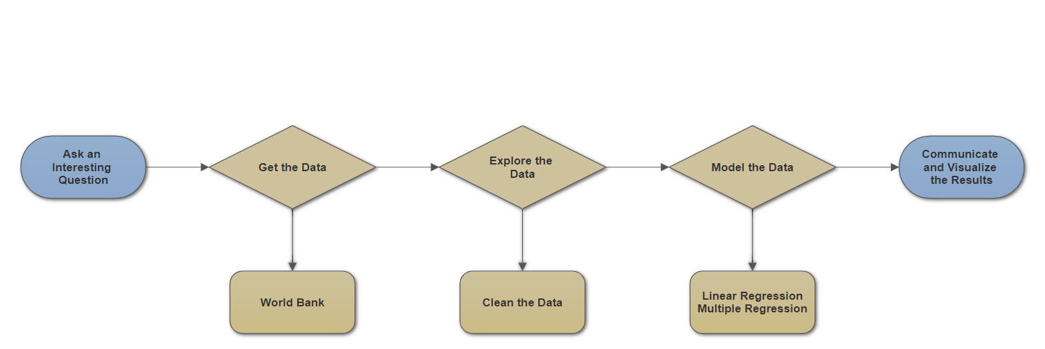
workflow

Slide 9
Evaluation/results

Slide 10
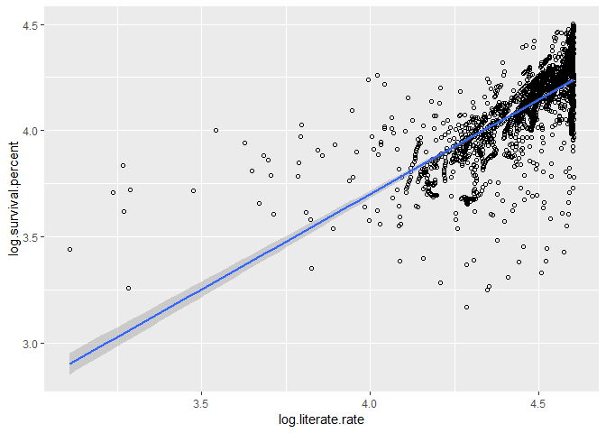
log of literate rate vs. Log of survival rate
Approximately 50% of the variation in the log of survival rate is explained by the log of the literate rate.
It's a log-log transformation, so it resulted in an interpretation that a doubling of the literacy rate of youth results in an 85% increase in the rate of survival to the age of 65.

Slide 11
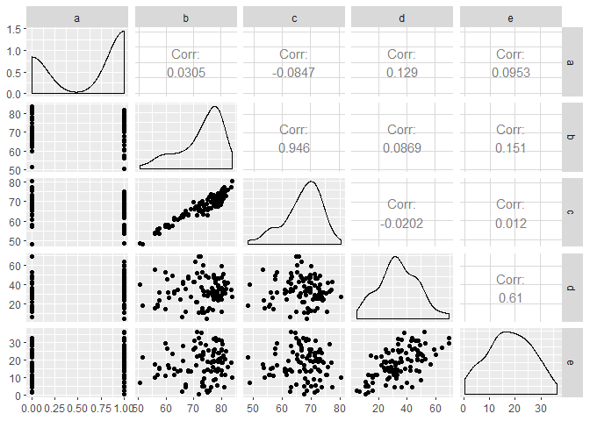
Multicollinearity plots matrix
There is minimum relationship between mother’s position maternity, female life expectancy, female participation, and female manager.

Slide 12
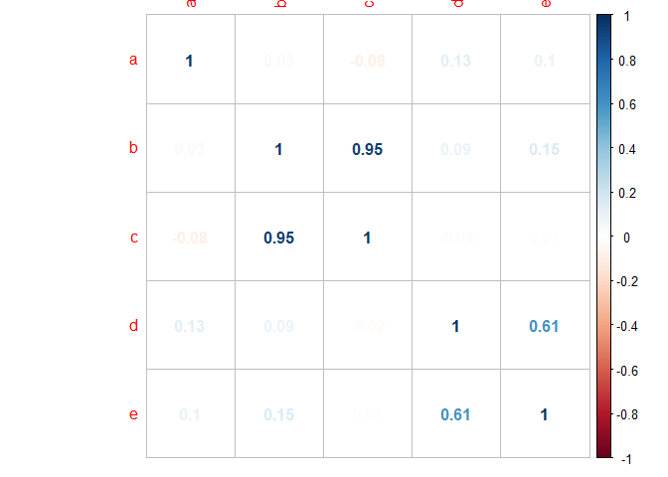
Correlation plots matrix
There is about 75% correlation between the 4 variables and survival rate.

Slide 13
Other things to consider
While our linear regression model shows ~50% correlation and our multiple regression model shows ~75% correlation, there are 162 total variables, so a stronger model and/or use of other variables may obtain higher correlation percentages.

Slide 14
summary

Slide 15
insights
Education and occupation have huge correlation to life expectancy and morality.
Therefore, the Bill & Melinda Foundation should expand and bring aid to countries with low literacy and low female occupation rates.

Slide 16
Recommendations
Since the Bill & Melinda Gates Foundation already has a huge presence in Africa, one area it cane expand to is Bangladesh in South Asia.
As of 2013, Bangladesh has a literacy rate of approximately 50% and a female occupation rate of 1%.

Slide 17
improvements
Our research can be improved by using a stronger model and/or testing other variables which may have higher correlation coefficients to survival rates.

Slide 18
questions

